Slide 1
Capstone Project: Phase One
Data Cleaning and Pre-Processing with Polypharmacy of GAP dataset
5/1/2019
Boyu Liu, Sixu Meng, Junchao Shen, Zhikang Jiang
Notes:
Hello Everyone, thanks having us. It a great pleasure to meet you all today. My name is Sixu
In this capstone course, We have had a wonderful research experience with polypharmacy team from URMC along this semester.
and Today we want to share our collaboration experience and progress with you in this presentation.

Slide 2
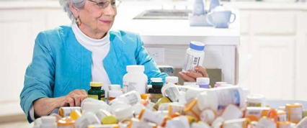
What is Polypharmacy?
Simultaneous use of multiple medications.
Extremely common in older adults.

Slide 3

Why does it matter?
Polypharmacy increases risk of death and other bad things…

Slide 4
Data Set Overview
GAP
A GERIATRIC ASSESSMENT INTERVENTION FOR PATIENTS AGED 70 AND OVER RECEIVING CHEMOTHERAPY FOR ADVANCED CANCER: REDUCING CHEMOTHERAPY TOXICITY IN OLDER ADULTS
Total Medications: 7426

Slide 5
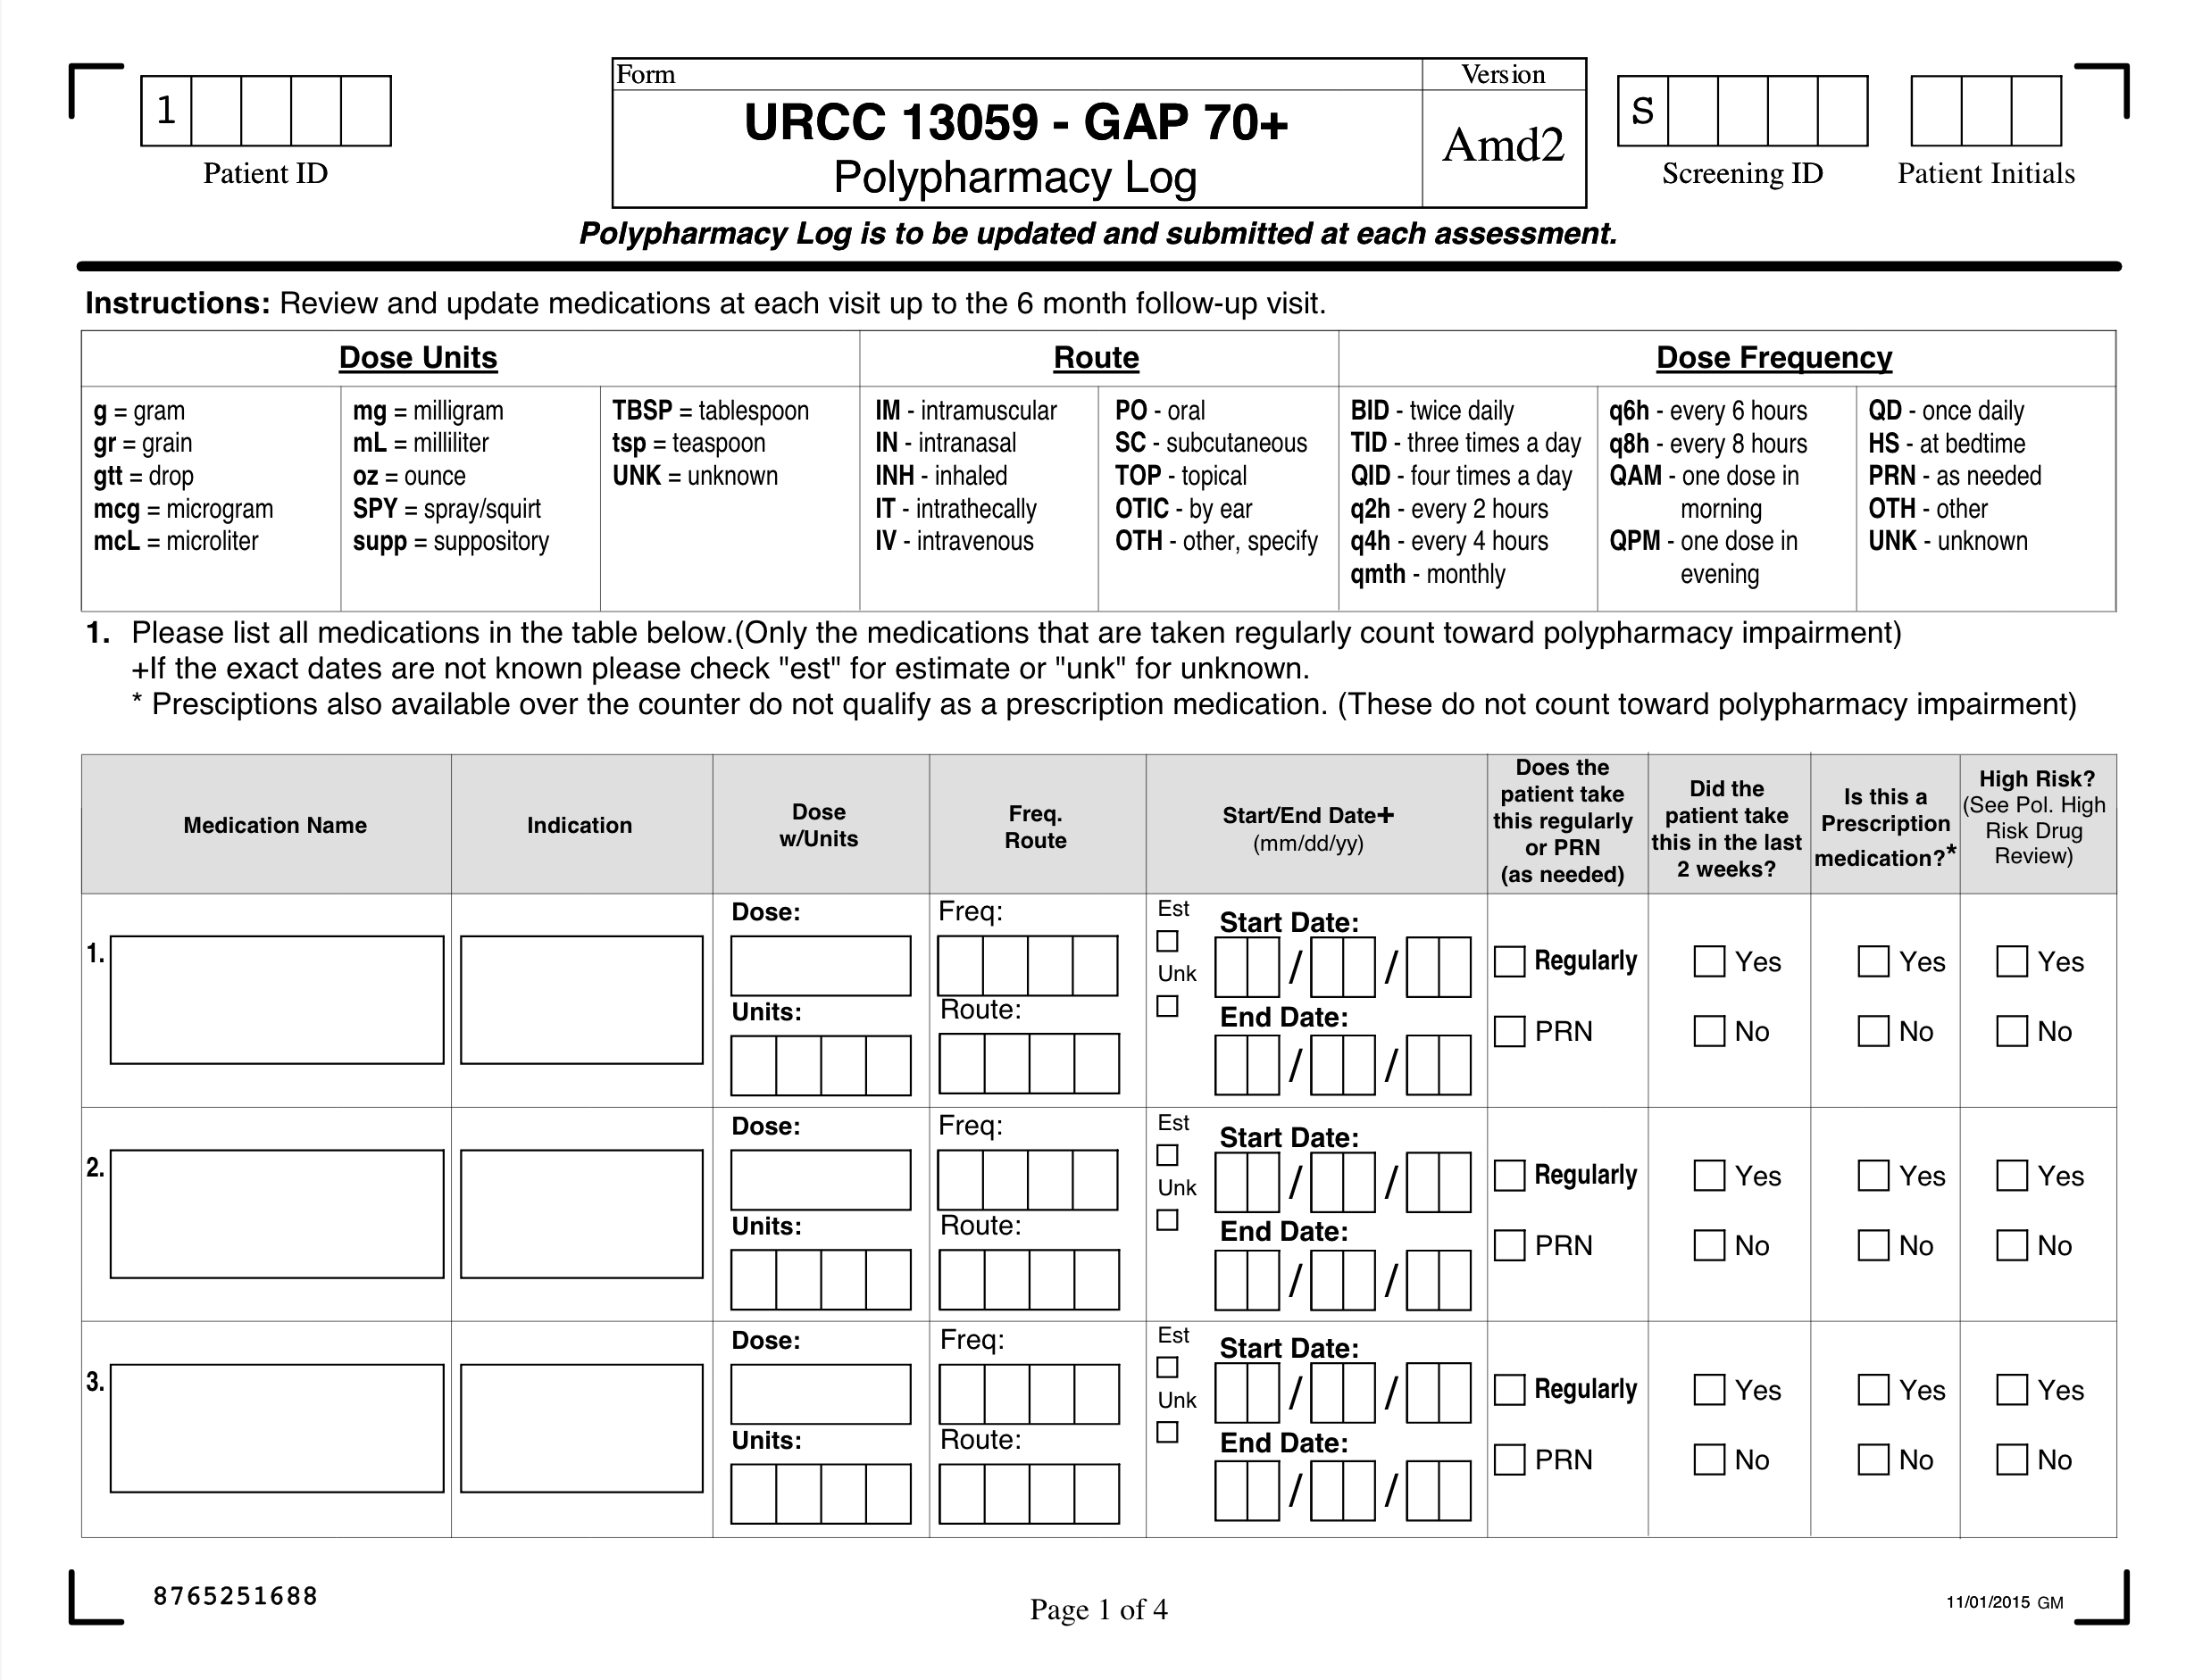
MANUALLY INPUT
MANUALLY INPUT
MANUALLY INPUT
Notes:
In the phase one of this project we were asked to clean some data for polypharmacy team.
For polypharmacy data, data were collected by this type of log forms which mainly based on human input

Slide 6
Data Overview
* Data is cleaning by Polypharmacy Team
Errors!
MANUALLY INPUT
Manually!
MANUALLY INPUT
MANUALLY INPUT
Notes:
Every time when it comes to Human inputs there is a sign misspelled errors!
Currently, data is cleaning by polypharmacy team, manually.
In phase one, we are helping polypharmacy to design a half - automatic system to clean the dataset.
to saves our clinician’s time and other resources.
The goal is to link patient ID with their medicines’ generic name correctly.

Slide 7
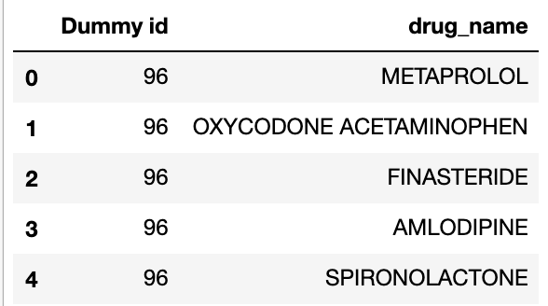
GAP Data Overview
Original Data
Generic Name
METOPROLOL
DOXEPIN
Correct Trade Name
Misspelled Trade Name
FINASTERIDE
Direct Matched
Wrongly input Generic Name
ACETAMINOPHEN
Correct Generic Name
Misspelled Generic
Name & Wrongly input
Notes:
First received this data set, we found there’s 3 types of error input
Correct three types of error existing in polypharmacy data:
Wrongly spelled Trade Name (美特普喽)
Wrongly put Generic Name （佛拿斯特ride）
Wrongly input and mispelled Generic Name （ a sei de 美扭芬）
Link with Correct Generic Name
Group by patient ID

Slide 8
Algorithm and Usage (Python)
import difflib¹
difflib.get_close_matches(word, possibilities, n = 3, cutoff = 0.6)
>>> get_close_matches(word = 'appel',
possibilities = ['ape', 'apple', 'peach', 'puppy'])
Output:
['apple', 'ape']
Can help matching by alphabet frequency pattern.
Return a list of the best “Good Enough” Matches
Returned in a list by similarity score, similar goes first.
¹https://docs.python.org/3/library/difflib.html
Notes:
Can help matching by alphabet frequency pattern.
Return a list of the best “Good Enough” Matches
The best matches among the possibilities are returned in a list, sorted by similarity score, most similar goes first.

Slide 9
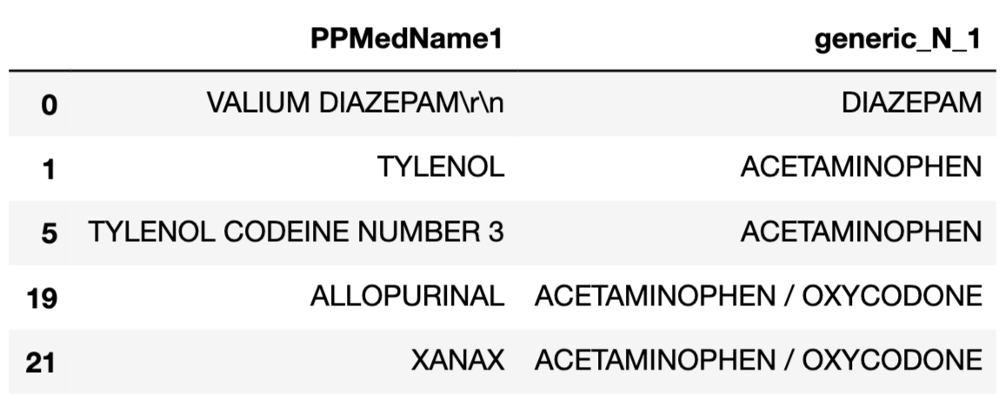
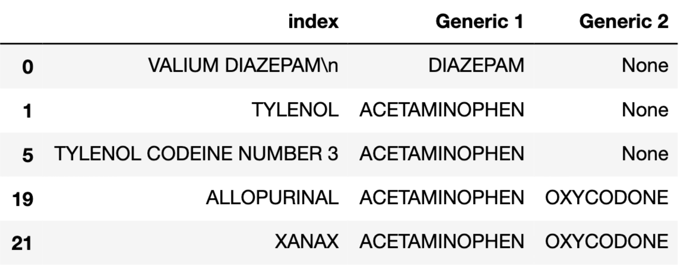
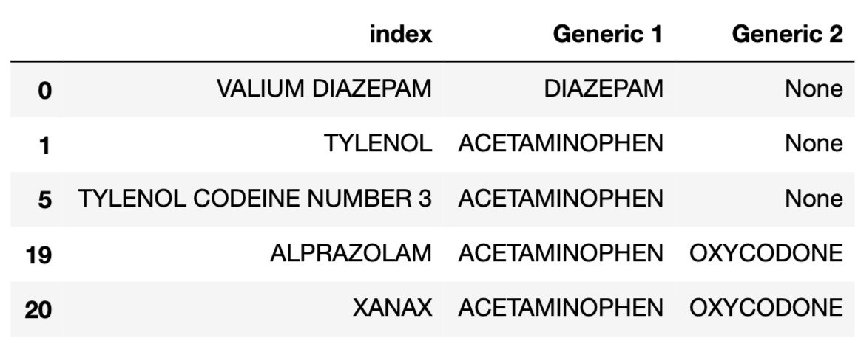
Data Cleaning
Reference Data For Trade & Generic
Split Generic Name
Output Cleaned Reference List
Remove blank & (\r\n)

Slide 10
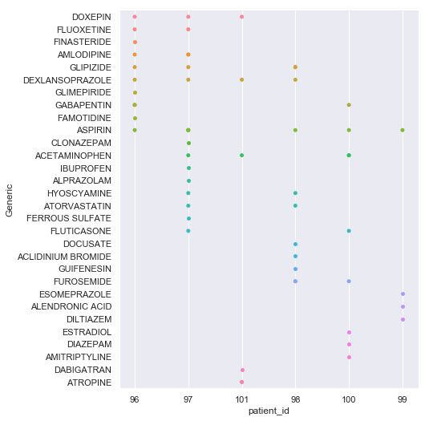
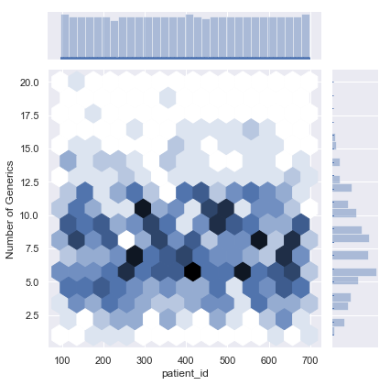
The Result
Number of Generics per Patient
Generic List per Patient (ID 96-101)
Notes:
On the left, the density graph shows number of generics each patient is taking.
With the horizontal distribution on the right, we can tell that the average number of generic is 5 to 7. which is a polypharmacy problem
But on the density map, we can see that within the range of patient id from around 300, they are having a higher average generics number and some of them may be over 10 which is an extremely polypharmacy.
Also the graph on the right shows the detailed generic list per patient. The vertical axis shows generic name and each dot represent one kind of generic the patient is taking.

Slide 11
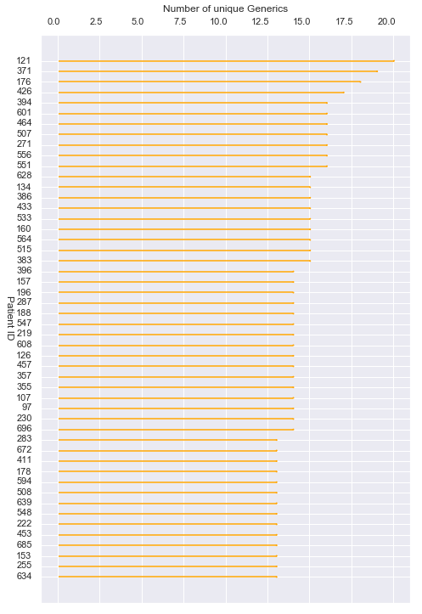
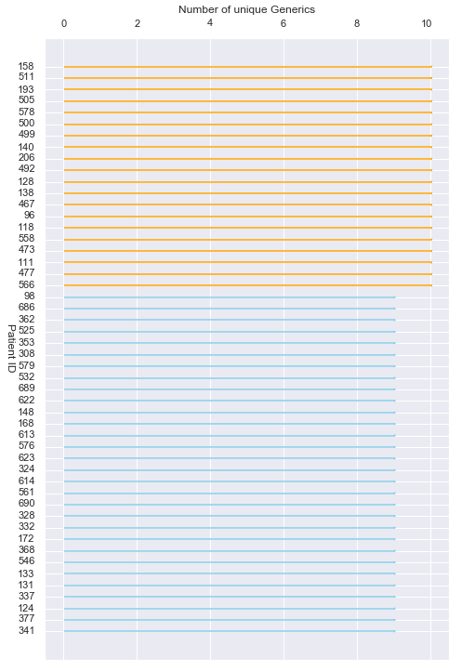

Slide 12
Capstone Project: Phase Two
5/1/2019
Boyu Liu, Sixu Meng, Junchao Shen, Zhikang Jiang

Slide 13
Hypothesis Development
Falling is Popular but not well studied in aging cancer population.
Potential Correlations: Falling and Cognitive function, Mental state, Motor function, Cancer type, Social function …
Logistic regression? Done!
Machine learning? Rarely!
Notes:
Falls are one of the leading causes of injuries in the aging people; 30% aging people over 65 years old are victim of falls; 10% of falls lead to serious damagel
Under the guidance of polypharmacy team, we realized falling is a popular topic in medical area, and is not well studied among aging cancer population
Previous studies revealed potential correlations between falling and cognitive function, mental state, motor function, cancer type, social function, etc.
Can we use cognitive performance, physical performance, cancer type, biomarker, social support and demographics information to predict how likely a patient is going to fall
Logistic regression is among the most commonly applied model in the clinical studies to predict falling rate.
However, machine learning techniques still rarely appeared in the medical literature.

Slide 14
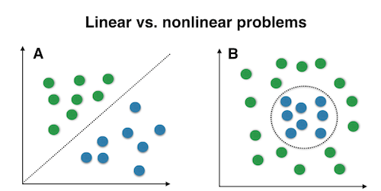
Why Machine Learning in clinical studies?
Linear Problem
More predictive power AND capability of accommodating non-linear dataset.
Better performance for high-dimensional dataset compared to regression
Supports a large volume and a wider range of clinical research data.
Example: Genome Data, MRI Data, CT Data, Lab Test, medical chart text
Non - Linear Problem
Notes:
traditional statistical methods has limitations when dealing with medical data
Machine Learning can introduces more predictive power than traditional statistical tools like regression and more capability of accommodating non-linear dataset.
Machine Learning technique has Better performance for high-dimensional dataset compared to regression
and most importantly Machine Learning supports a large volume, and a wide type of clinical research data such as Genome Data, MRI Data, CT Data, Lab Test, and even medical chart text data.

Slide 15
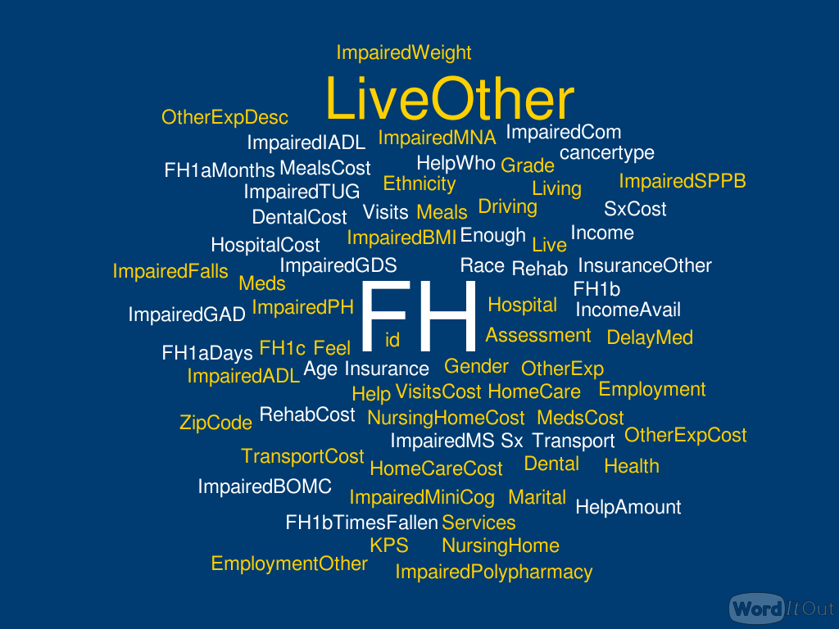
Data Overview
77 Features
35
Less than 15 missing value
5
Non numeric features
Notes:
Here comes to Data Overview, there are 77 features in total, which contains both numerical and categorical data. Then, we select 35 features which has less than 15 missing values to further perform. For feature in numeric, we filled up all the missing values by median or mode. Moreover, we are using groups’ median to fill up the continuous missing data and using mode to fill up the discrete missing data. Among those 35 features, only 5 of them is non numeric features. In the next slide I will show you how we clean those categorical data.

Slide 16
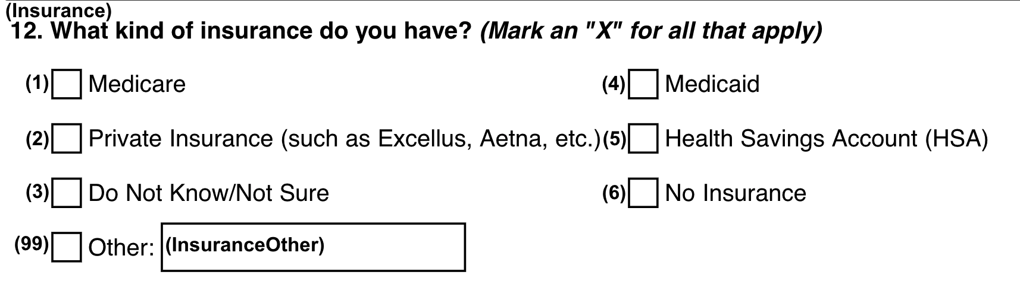
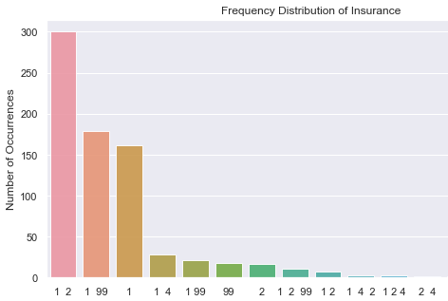
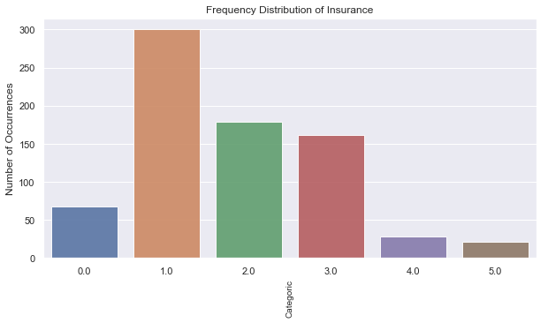
Data Cleaning
Insurance
Non-numeric Features
Notes:
For categorical data, basically what we did is to distribute the data by its frequency and combine them with the minority group. Take insurance as an example, we assigned five major categories with numbers and classified them into five categories with the significance in Medicare and Private Insurance. Assign numbers to categorical data.

Slide 17
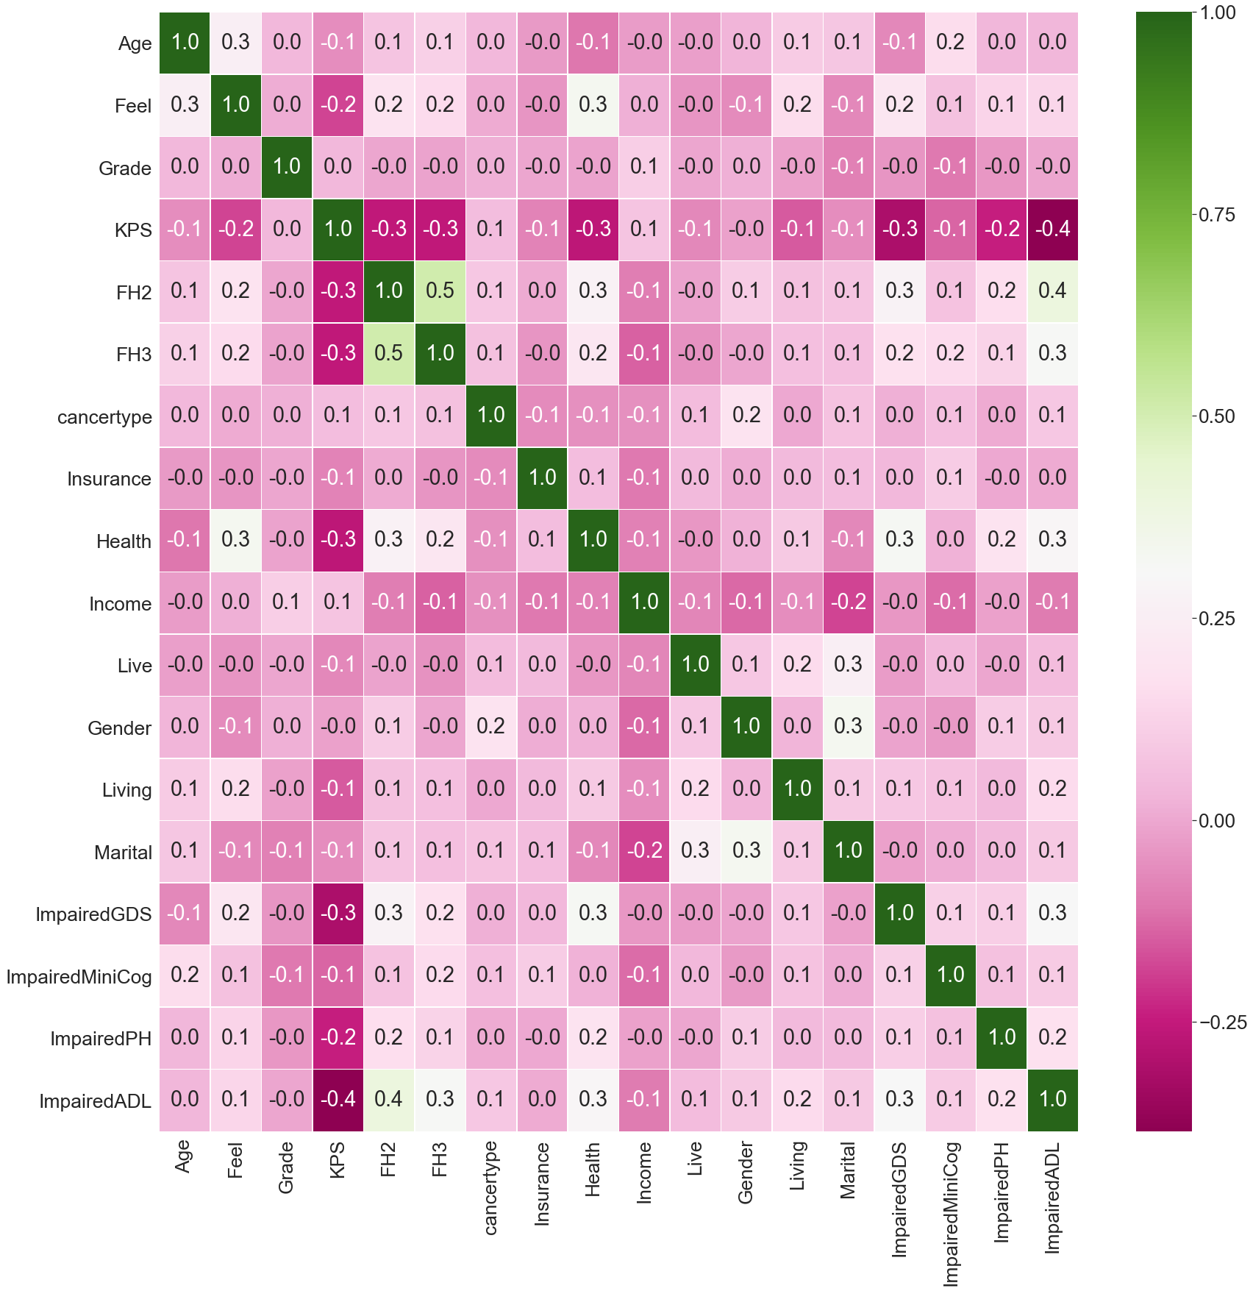
Correlation Matrix
FH2:
In the past 12 months, are you afraid that you might fall?
FH3:
Do you ever limit your activities because of afraid falling?

Slide 18
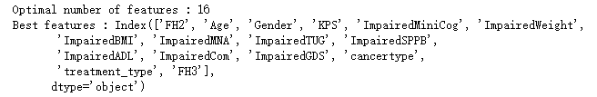
Feature Selection
RFECV (recursive feature elimination using cross validation)
a technique which not only ranks feature importances, but also provides how many features we need for best accuracy or best auc area.
we may be able to explore the realistic clinical meaning of these features based on the result.
Notes:
random forest as estimator to estimate model performance
split the dataset into several partition
recursively consider smaller and smaller set of features

Slide 19
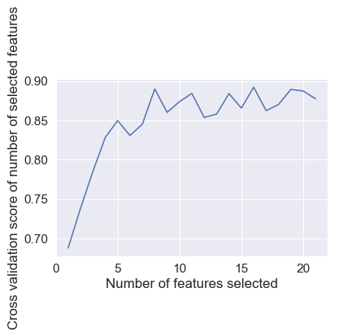
Feature Selection
Also, the algorithm provides us a graph about AUC vs. Number of features:
Notes:
After increasing the number of features to 8, the performance start to rise and fall between .85 and .9

Slide 20
Feature Selection
Tree based feature selection
use random forest classifier to compute the feature importances
the higher the importance, the more importance the feature is
After performing two feature selection techniques, we combine the results of both to select several features to achieve better accuracy.

Slide 21
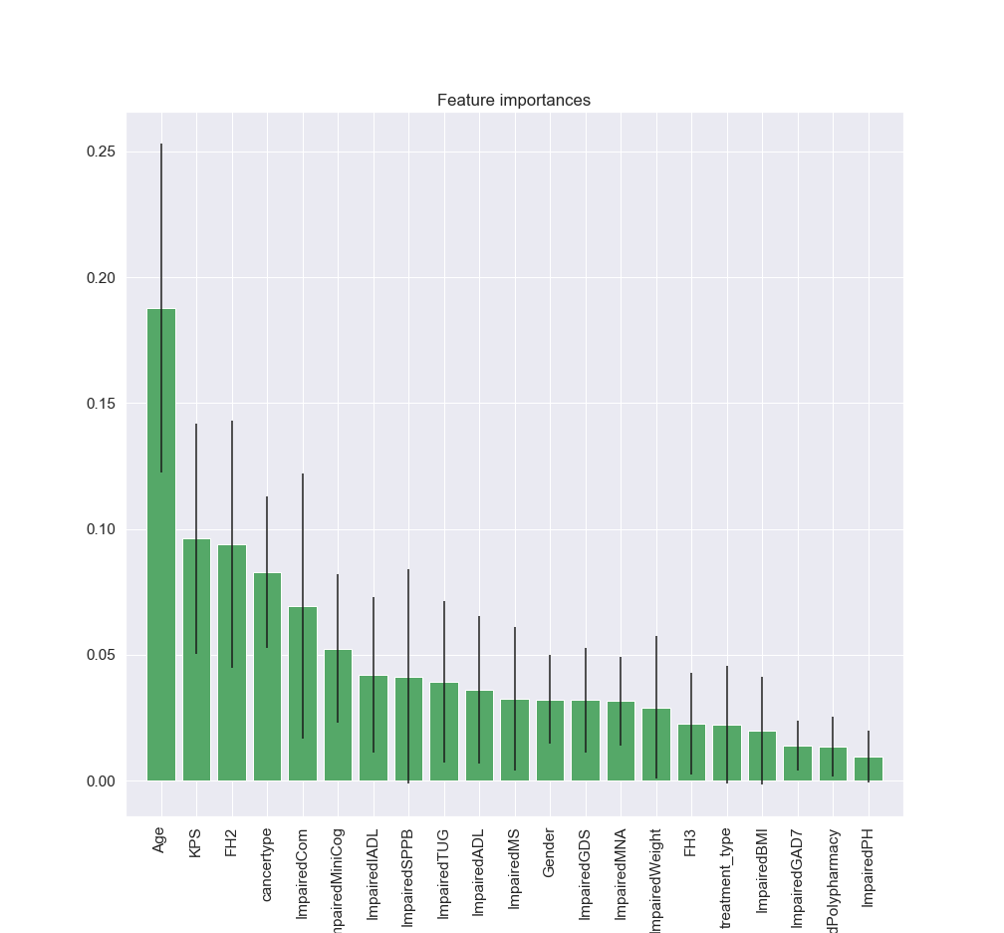
Feature Selection (continue)
Feature ranking:
1. feature 1 (0.187724)
2. feature 3 (0.096173)
3. feature 0 (0.093839)
4. feature 18 (0.082953)
5. feature 14 (0.069396)
6. feature 5 (0.052483)
7. feature 12 (0.041937)
8. feature 10 (0.041418)
9. feature 9 (0.039303)
10. feature 11 (0.035993)
11. feature 17 (0.032557)
12. feature 2 (0.032275)
13. feature 16 (0.031939)
14. feature 8 (0.031554)
15. feature 6 (0.029131)
16. feature 20 (0.022502)
17. feature 19 (0.022093)
18. feature 7 (0.019923)
19. feature 15 (0.013931)
20. feature 4 (0.013353)
21. feature 13 (0.009525)
Notes:
In sklearn package, random forest classifier has a parameter called feature importance. The sum of all feature importance is equal to one. The importance of feature represents how many percent of data it can represent

Slide 22
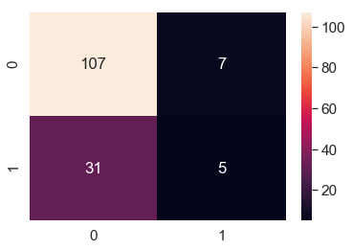
Initial Modeling
Random Forest and Confusion Matrix
Accuracy_score?
Confusion Matrix
>>> from sklearn.metrics import accuracy_score
>>> accuracy = accuracy_score(y_test, y_pred)
Accuracy: 74.67%
Not Fall
Actual
Fall
74.67%
Not Fall
Fall
Prediction
Notes:
Since ML is so powerful, we started building our model immediately after received the data,
We pulled in the data, run the model and here is the result we got at the first time.
It’s 74%, now it seems the problem has been solved. It’s no doubt that Professor is going to give me an A in this course.
But when it comes to drawing the confusion matrix , we realized, this is not an A but a C- we are going to receive.
Just for your reference, the confusion matrix show the prediction result of each machine learning model.
And now we can see, the high accuracy rate was just an illusion. The model accuracy is predicting almost every patient not falling!!!

Slide 23
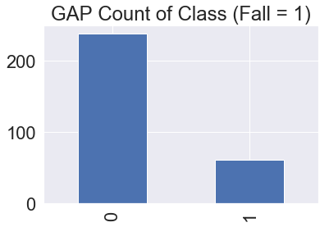
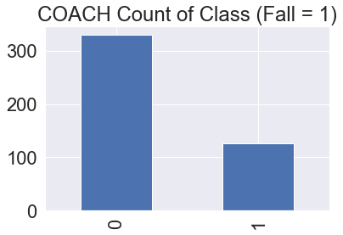
Data Overview
Imbalanced Dataset
How unbalanced the dataset is?
Class 0: 238
Class 1: 61
Proportion: 3.9 : 1
Class 0: 330
Class 1: 126
Proportion: 2.62 : 1
Notes:
So we went back to check how imbalanced the datasets are. It turns out that the average proportion from not fall to fall is about 3:1.
Is there anything we can do to change this situation?

Slide 24
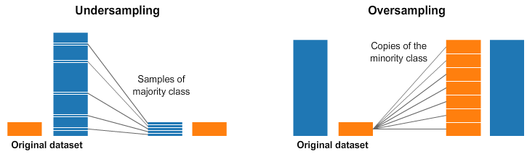
Data Resampling
A widely adopted technique for dealing with highly unbalanced datasets is called resampling. It consists of removing samples from the majority class (under-sampling) and / or adding more examples from the minority class (over-sampling).
Notes:
Yes, there’s A widely adopted technique for dealing with highly unbalanced datasets which is called resampling.
It consists of removing samples from the majority class (under-sampling)
and adding more examples from the minority class (over-sampling).

Slide 25
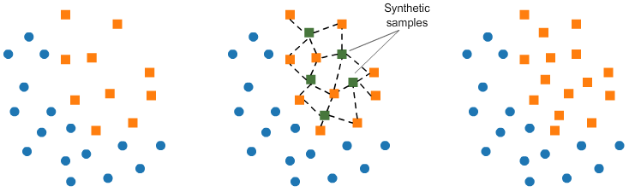
Data Overview
Over-Sampling: SMOTE
Commonly used resampling algorithm for clinical data.
Notes:
One of the technique from over-sampling is called. SMOTE
SMOTE is the most commonly used resampling algorithm for clinical data.
SMOTE consists of synthesizing (森色sizing) elements for the minority class, based on those already exist data.
It will randomly pick a point from the minority class and computing the k-nearest neighbors for this point.
In the end, The synthetic(森赛tic) points are added between the chosen point and its neighbors.

Slide 26
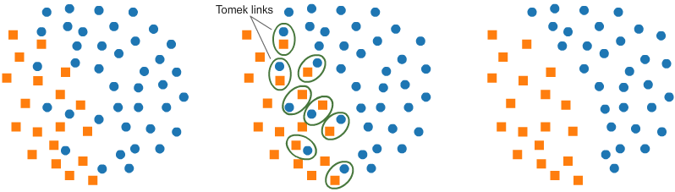
Data Overview
Under-Sampling: Tomek Link
Tomek links are pairs of very close instances, but of opposite classes.
Notes:
The under-sampling technique we picked to use with SMOTE is called tomek
Tomek Links remove unwanted overplay between classes
where majority class links are removed until
all minimally distanced nearest neighbor are of same class.
After using Tomek Links, it will be easier for machine learning algorithms to distinguish the difference between class A and class B
In the end, we perform SMOTE first to generate more samples in minority class, and then, we use Tomek Links to clean overlaps between majority and minority classes.

Slide 27
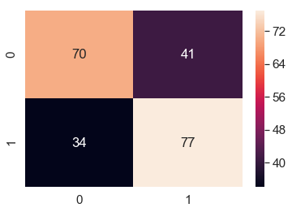
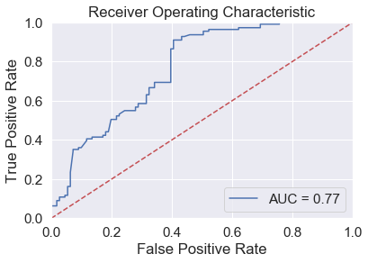
Secondary Modeling
Confusion Matrix and ROC curve
Confusion Matrix
*Resamped Testing Set
Not Fall
Actual
Fall
Not Fall
Fall
Prediction

Slide 28
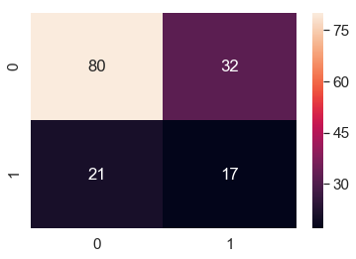
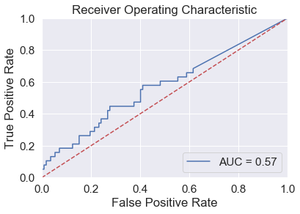
Secondary Modeling
Confusion Matrix and ROC curve
Confusion Matrix
Not Fall
Actual
Fall
Not Fall
Fall
Prediction
Failed

Slide 29
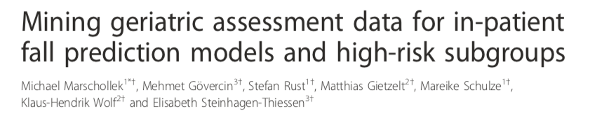
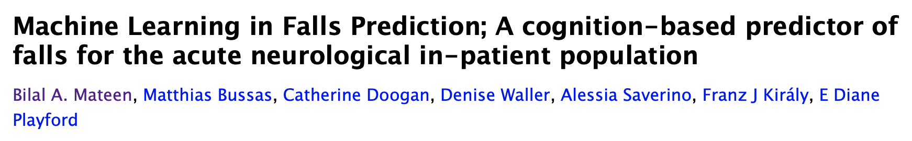
Previous Literature in Fall Prediction using ML
Combined Social Status/Barthel index/Lachs score/POMA/MMSE to make the fall prediction: sensitivity:55.4%, specificity: 67.1%, accuracy:66% (Marschollek,et al.2012)
Combined Trail Test/Scoop Test/Semantic Test/Walk-12 to predict fall: Sensitivity: 50.8%, Specificity: 92.4%Precision: 58.5% (Matteen,et al.2016)

Slide 30

Why recall is important?
After applying both oversampling and undersampling techniques, it is unsuitable to apply any resampling technique to test dataset.
Thus, we apply undersampling technique only to train dataset to resolve the issue of class imbalance.
Meanwhile, we find out, in medical scenario, recall score is more important than accuracy score.
We care more about how accurate our model can predict patients who are impaired by falling.

Slide 31
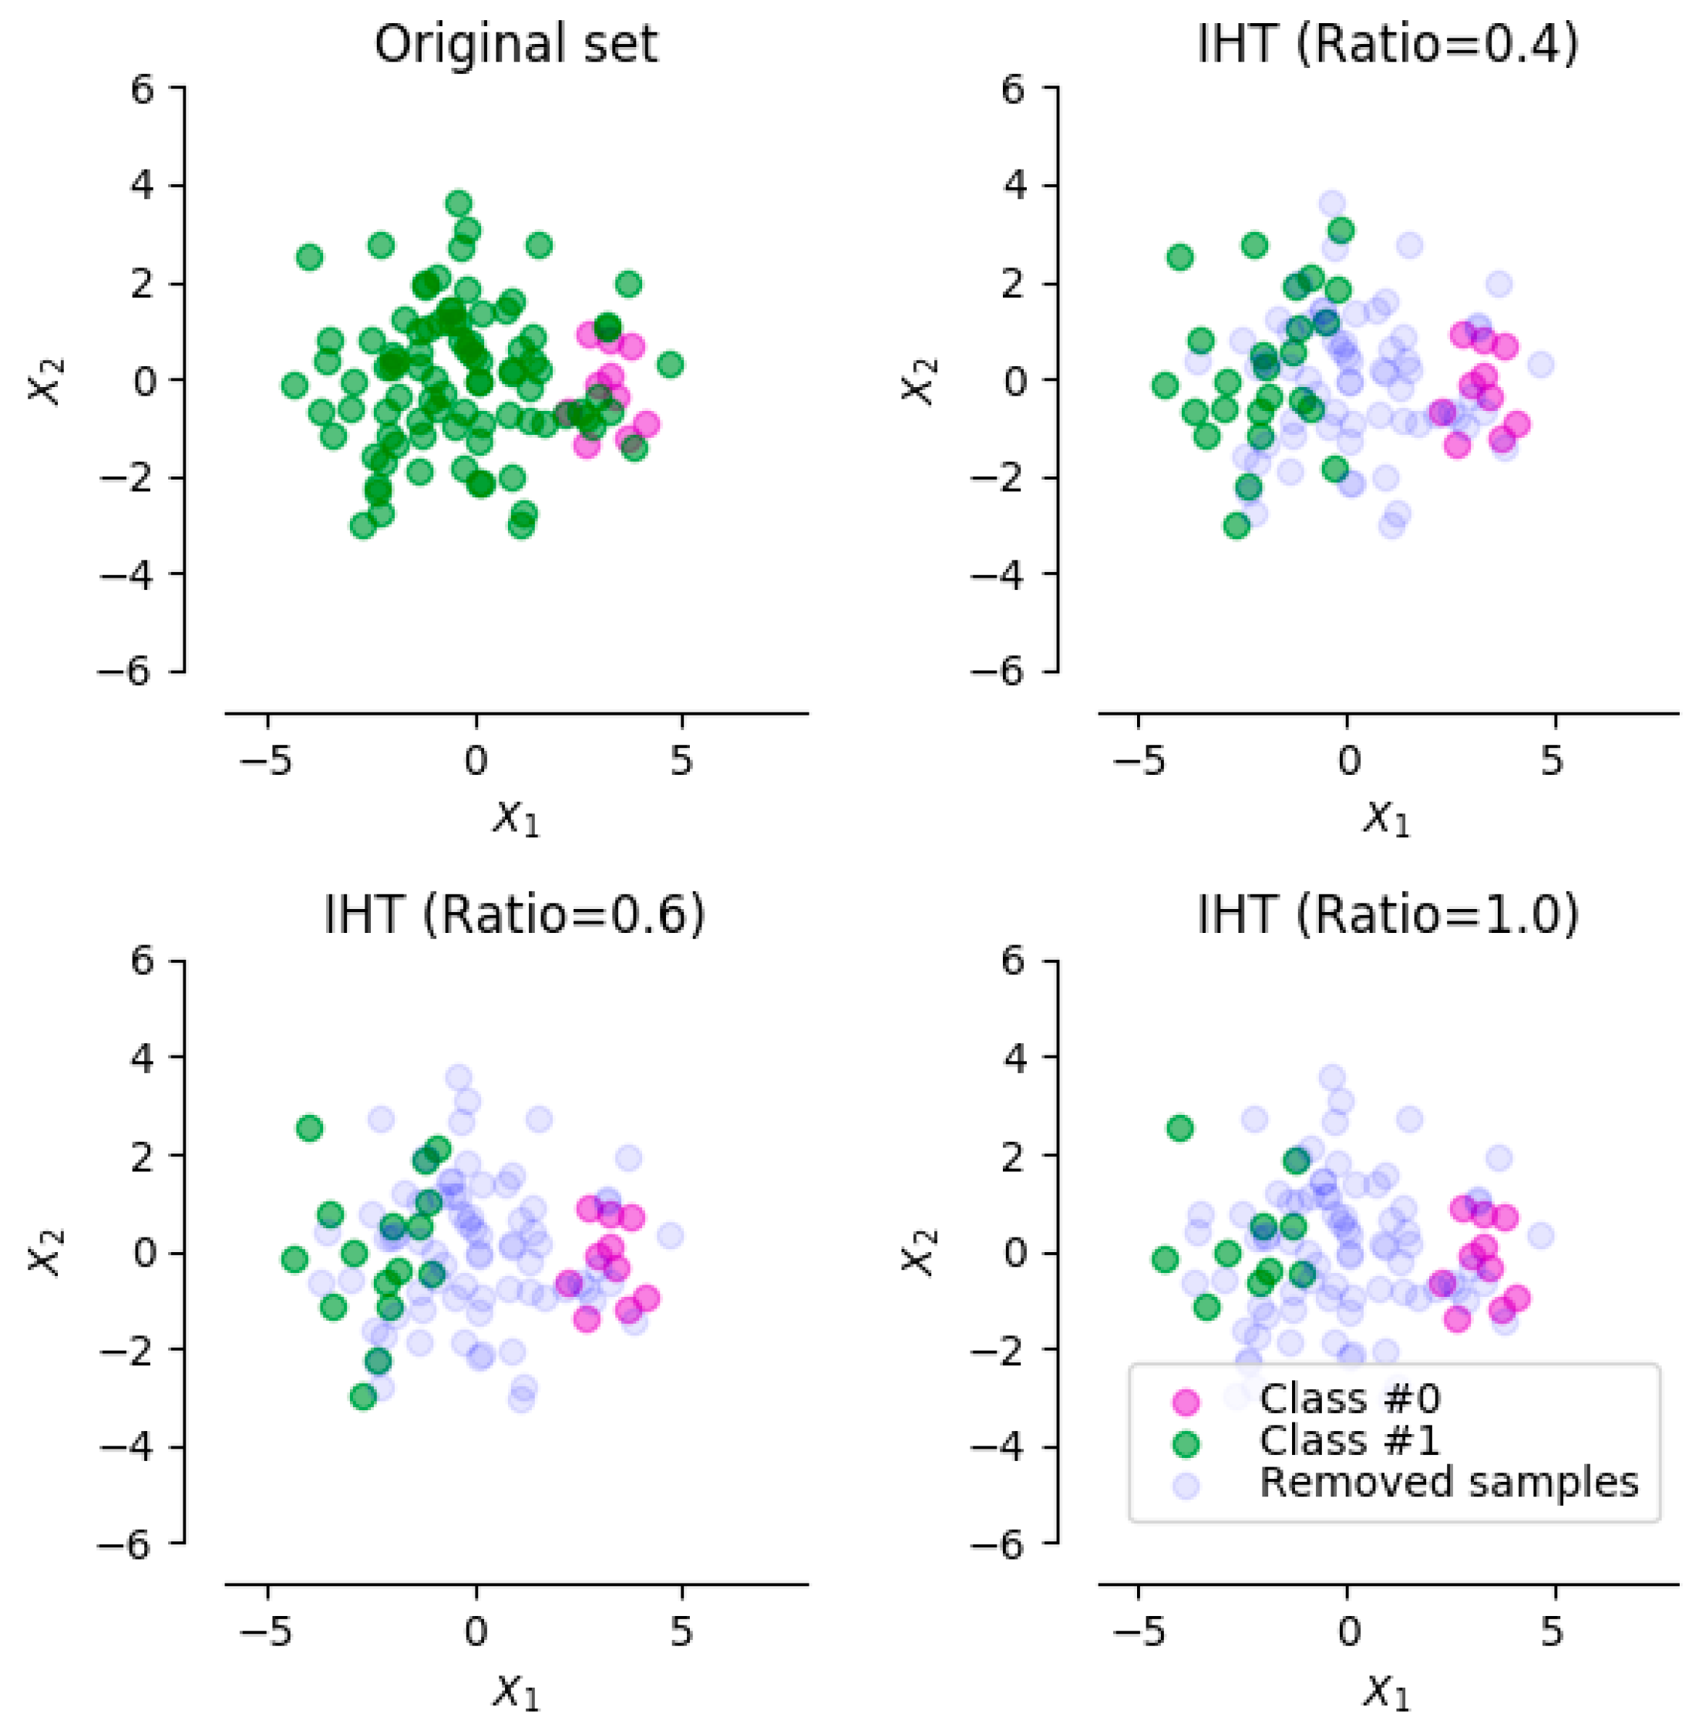
Instance Hardness Threshold
An undersampling technique proposed in 2014 for binary classification problems with a highly imbalanced dataset.
Data samples that are on the borderline between two or more classes or characterized by noise have high IH values due to the fact that a learning algorithm would force them to overfit correctly.
Remove data points near the decision line that have a high probability of being misclassified given specific model

Slide 32
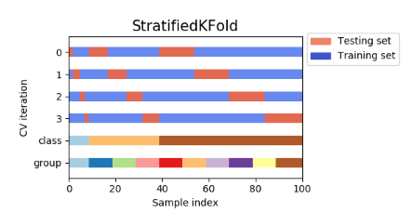
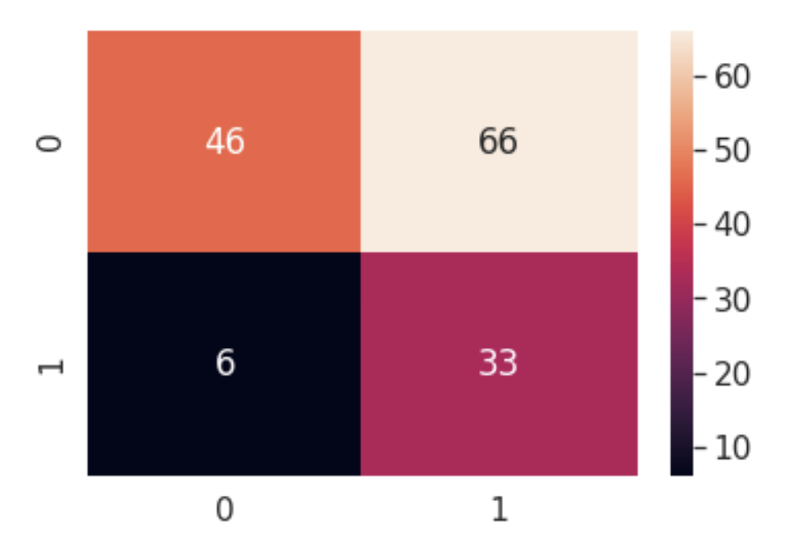
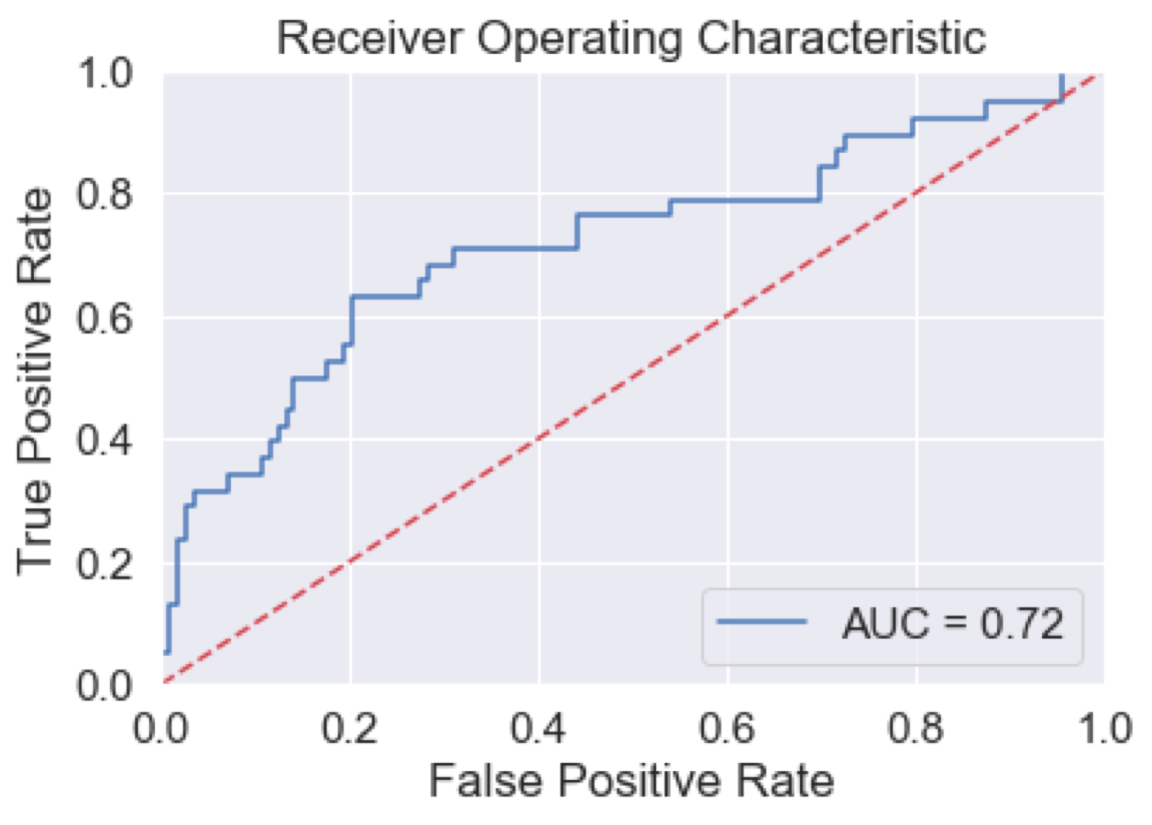
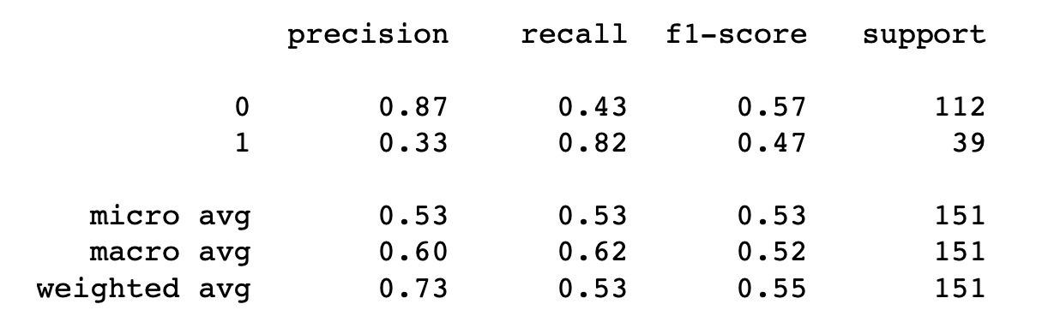
Third Modeling
Logistic Regression Cross Validation

Slide 33
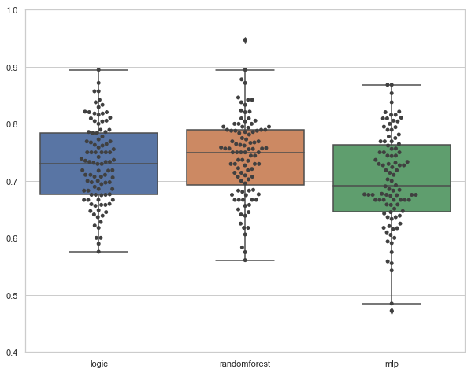
Logistic Regression vs Other ML Algorithms
Sensitivity
Logistic Regression
Random Forest
MLP

Slide 34

Practical Usage
Logistic Regression Probability
Patient ID 134
Cancer Type : 2
Health : 2
Grade : 7
Age : 1
FH2 : 1
Live: 1
KPS: 3
…
0.242
Falling Probability
Did not fall in past 6 month

Slide 35

Practical Usage
Logistic Regression Probability
Patient ID 232
Cancer Type : 1
Health : 5
Grade : 5
Age : 1
FH2 : 2
Live: 1
KPS: 3
…
0.823
Falling Probability
Fall in past 6 month

Slide 36
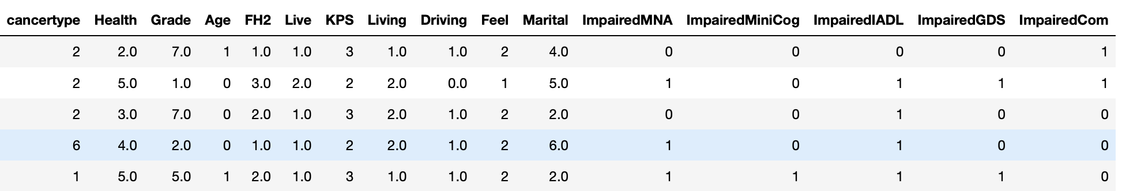
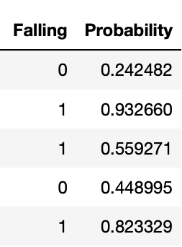
Practical Usage
Logistic Regression Probability
For each patient, logistic regression model can produce an estimated probability of falling.
In binary classification task, 50% is used as threshold for classification.
Clinically, a higher threshold needed for more certainty
Notes:
For each patient, logistic regression model can produce an estimated probability of falling.
In binary classification task, 50% is used as threshold for classification.
Clinically, a higher threshold needed for more certainty

